Slide 1
Module Group Project IMDCGD111-16YRD Module managing games production imdcgd214-16yrd level 4/5 Group 13 Eat them
Heidi Falcon - George Flude

Slide 2
Logline
Players aim to eat bubbles while avoiding obstacles and the first one to eat their opponent, wins.

Slide 3
Meeting the brief
2D adversarial simultaneous gameplay with symmetric design.
Use of buoyancy physics concept.
Simple and intuitive rules

Slide 4
Target Audience
16-25 either gender. Casual gamers
Fast paced, simultaneous gameplay which allows for social fun,
http://www.eldergame.com/2008/05/define-your-target-audience/
http://serious.gameclassification.com/EN/about/bricks.html#PUBLIC

Slide 5

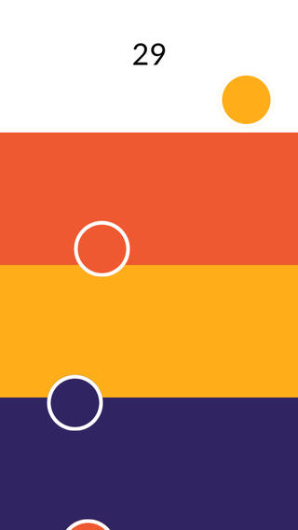
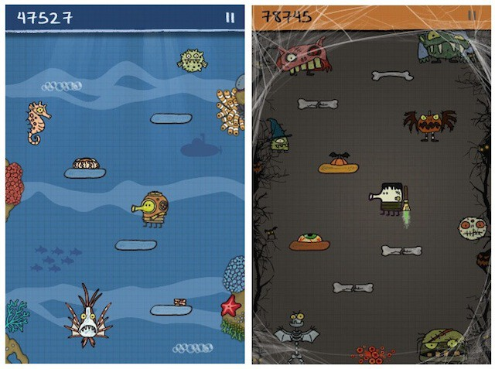
Research
We researched games and took inspiration from:
http://www.ologame.com/
https://itunes.apple.com/gb/app/circo/
http://doodlejump.org/

Slide 6
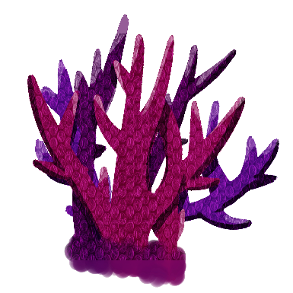






Mechanics and Assets
Gameplay
Eating/Absorbing
Throwing/Avoiding Obstacles

Slide 7
Physics
Buoyancy:
Players fight against a force of buoyancy, creating unpredictability in gameplay.

Slide 8
Emotions
Competitiveness: Giving the winner bragging rights
Struggle: Race to gain higher score, to avoid obstacle.
Strategy: Plan to position obstacles to hinder opponent.
Aggressiveness: Game requires players to concentrate on attacking as well as defending their environment.

Slide 9
Iterations
It was purely a game of skill
Spawning of obstacles
Grabbing mechanic allows for strategies to be planned
Thruster, can be improved on movement, so its not as predictable

Slide 10
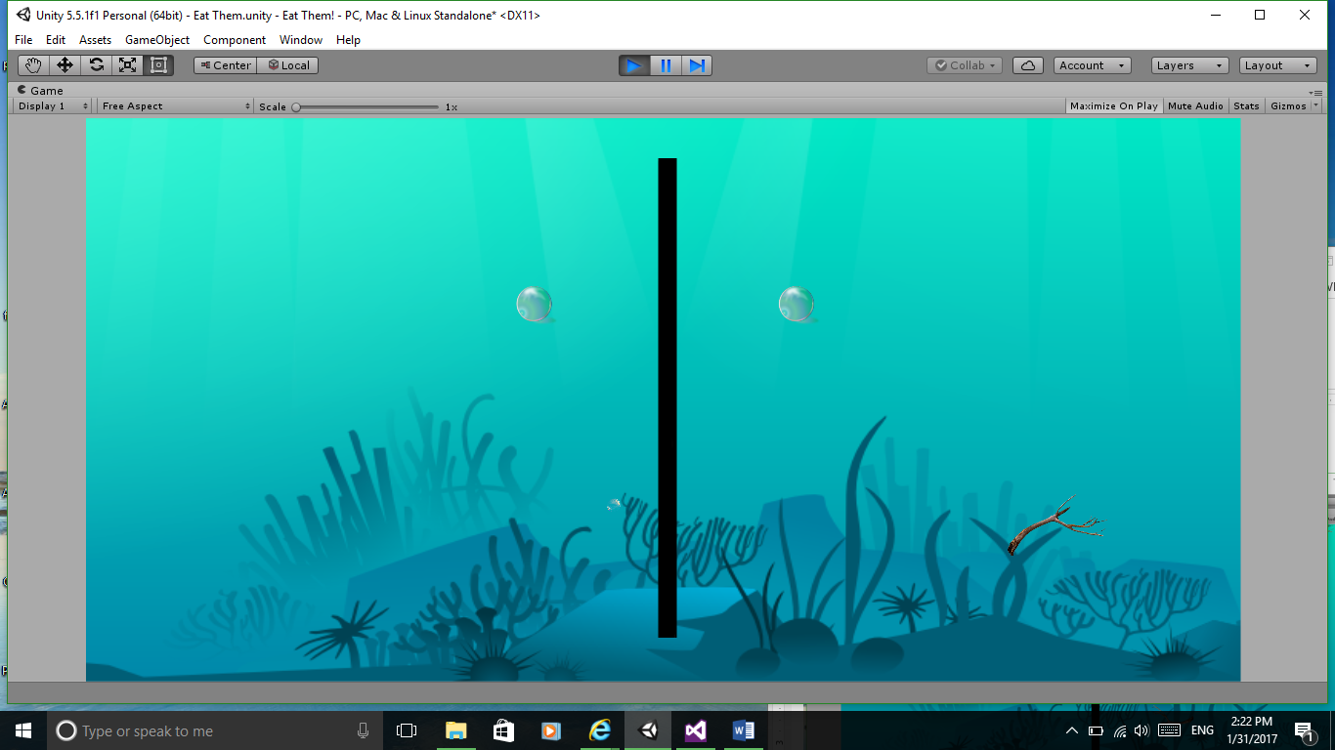

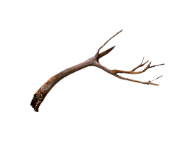




Prototype 1

Slide 11

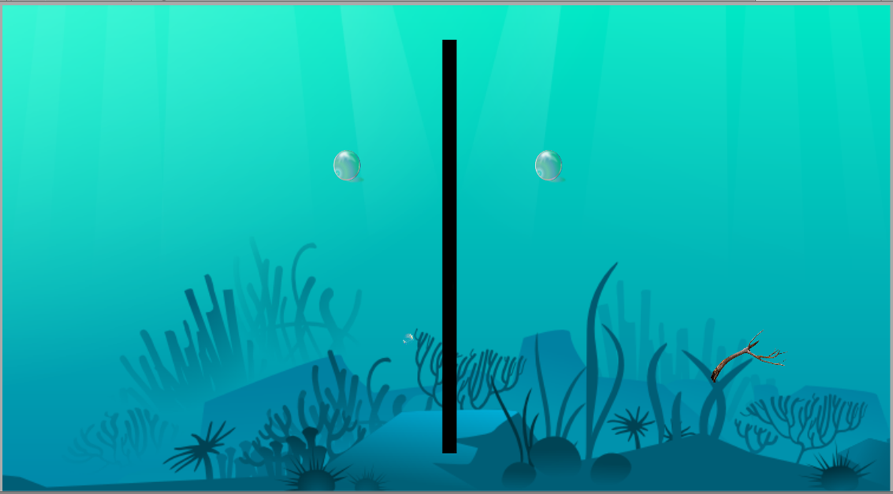


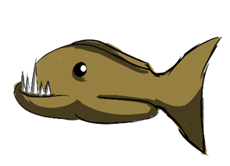
Prototype 2

Slide 12
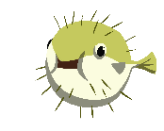

Prototype 3

Slide 13
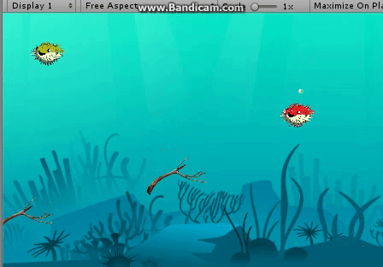
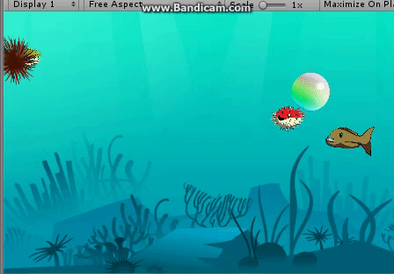
The Game

Slide 14
Playtest Feedback
Q-1 Liked? 80% Theme
Q-2 Didn’t like?
60% Controls
40% Screen too busy
Q-3 Implied instructions? 80% No
Q-4 Change?
60% Instructions/ Controls
40% Theme/ Player design.

Slide 15
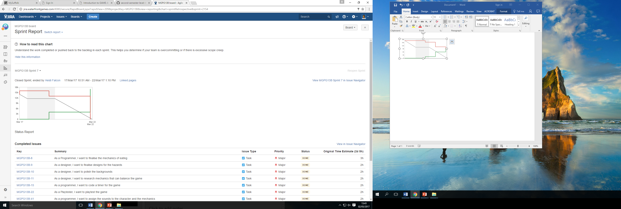
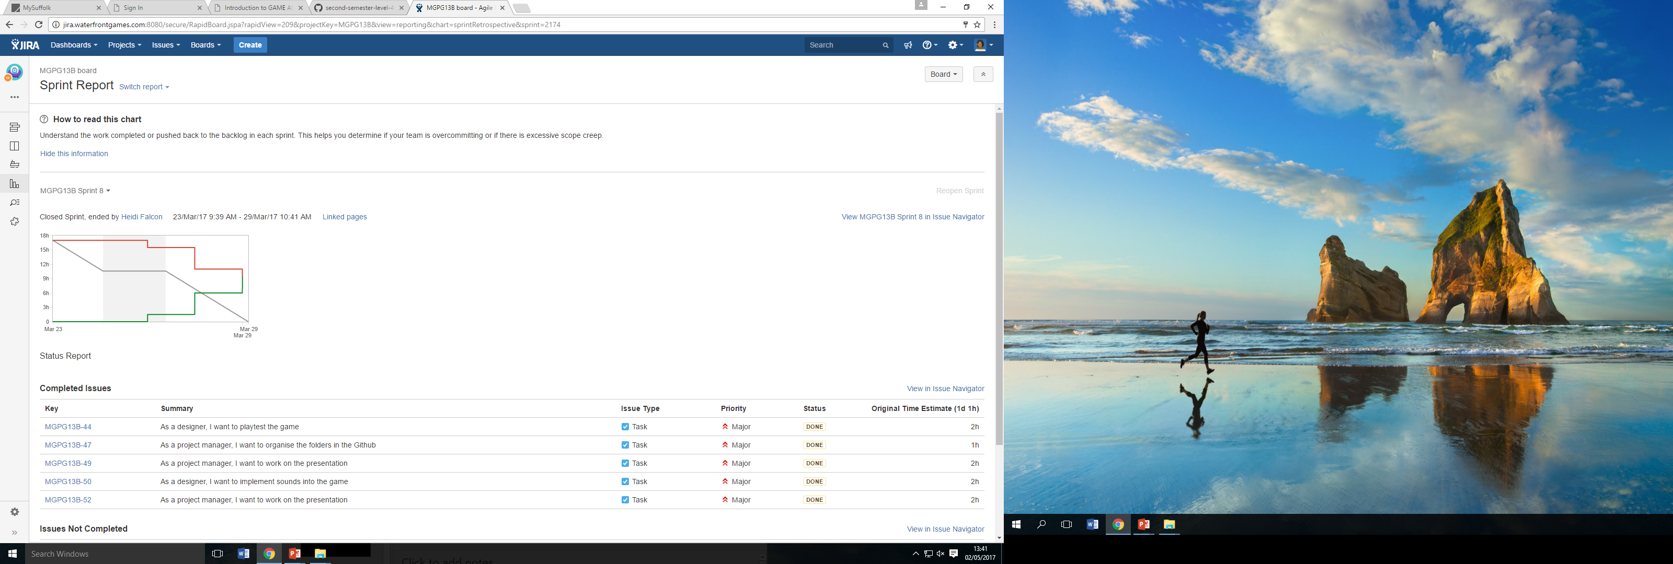
Management
Emails:
George: 44
Heidi: 47
Macaulay: 5
Hours:
George: 40
Heidi: 40
Macaulay: 0
Sprint 7
Sprint 8

Slide 16
Final tasks reviewed
Polish sounds
Polish eating mechanics
Create timer
Polish buoyancy (Physics drive the game)
Playtest

Slide 17
What we have learnt
Ensure we fully understand the brief
Make sure the theme is more informed
Determine team’s commitment
Determine skill levels
Begin prototyping earlier
Don’t be afraid to change the game

Slide 18
What would be different
Iterate more
Play test more
Make sure physics mechanics are implemented at start
Communication could be improved
Ensure the brief is followed at every stage

Slide 19
Questions?

